Slide 1

Winter Safety & Preparedness
Your Responsibility
Notes:
Welcome to our Winter Safety and Preparedness presentation. As we approach the winter months, our goal today is to equip you with the knowledge and strategies necessary to navigate this season safely.
Throughout this presentation, we will cover a variety of crucial topics, from understanding winter weather alerts and preparing your home and vehicle for cold conditions, to assembling emergency kits and ensuring clear communication, especially for amateur radio operators.
We will discuss the importance of staying informed through weather advisories, the steps to take to conserve heat and manage resources during a storm, and how to maintain safety when stranded in your vehicle. Additionally, for our amateur radio community, we will delve into the specifics of preparing your equipment to ensure it remains operational in harsh winter conditions.
Remember, winter weather can be unpredictable and severe, so taking proactive steps to prepare can make a significant difference in safety and comfort. By the end of this session, you will have a comprehensive checklist of actions and a deeper understanding of why these measures are so vital. Let's get started and ensure we're all ready to face whatever this winter brings us.

Slide 2
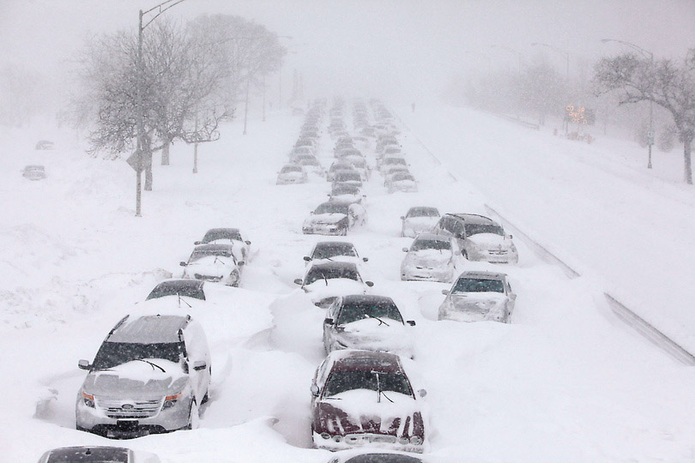
Why be Prepared?
Freezing Rain
Snow
Sleet
Ice
High Winds
Cold Temps & Wind Chill
Or any combination of the above
Notes:
Let's start by understanding why preparation is critical. The winter months bring a variety of challenging weather conditions.
Freezing rain can coat everything in ice, making travel by car or foot treacherous. Snow, while it can be scenic, accumulates quickly, affecting visibility and mobility.
Sleet, a mix of rain and snow, can slicken surfaces unexpectedly. Ice, often unseen, is a major cause of winter accidents.
High winds not only decrease the temperature but can also create snow drifts and knock out power lines.
And of course, cold temperatures paired with wind chill can lead to dangerous conditions like hypothermia and frostbite. Preparing for these conditions is not just about comfort, it's about safety. By the end of this presentation, my goal is for all of you to have the knowledge and tools necessary to stay safe and warm all winter long.

Slide 3
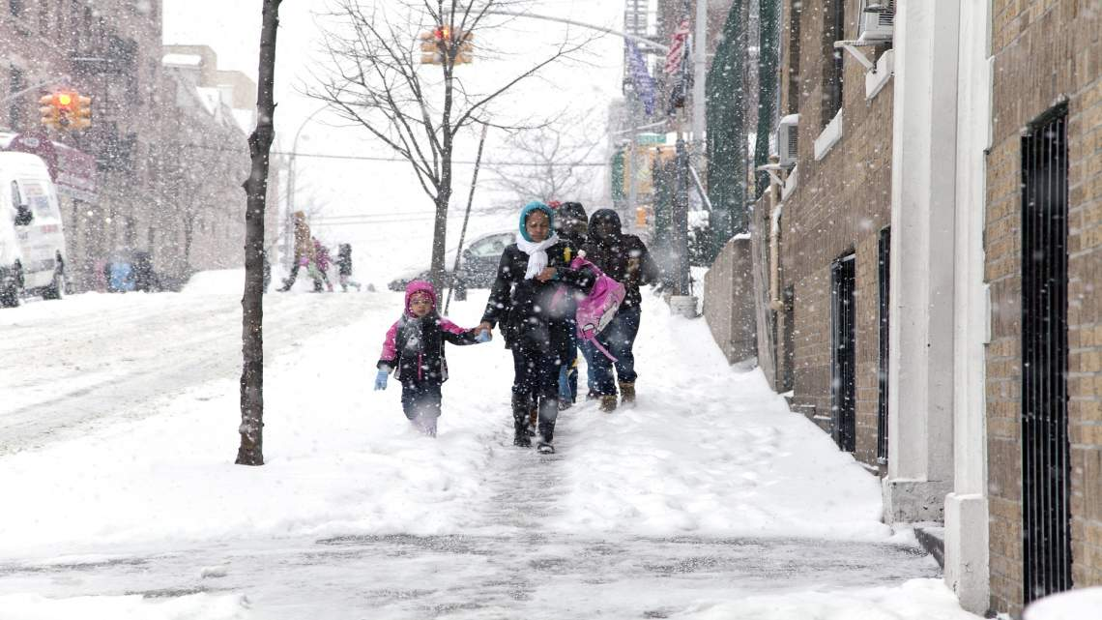
What To Be Prepared For:
Power Outages
Stranded Motorists
Driving Hazards
Communications Outages
Walking Hazards
Risk of Carbon Monoxide Poisoning
Risk of Hypothermia-Core Body Temp. drops below 95 deg.
Risk of Frostbite
Notes:
These are some of the primary concerns we must be prepared for during the winter season.
Power outages are common as winter storms can down power lines. It's crucial to have alternative heating methods and emergency lighting available.
Stranded motorists can be a frequent occurrence; hence, it's vital to have an emergency kit in your vehicle, including blankets, food, water, and a first-aid kit.
When it comes to driving hazards, it's not just about ice and snow on the roads; visibility can be severely reduced, and stopping distances can dramatically increase.
Communication outages can cut us off, so have a way to charge your cell phone, and consider owning a hand-crank or battery-operated radio to stay informed.
Walking hazards are often overlooked; slips and falls can lead to serious injuries. Wear appropriate footwear and be cautious.
The risk of carbon monoxide poisoning increases with the use of generators or grills indoors; always ensure proper ventilation.
Hypothermia occurs when the body's core temperature drops below 95 degrees Fahrenheit, so dress in layers and stay dry.
Lastly, frostbite can happen within minutes in extreme conditions, particularly on exposed skin, so cover up and recognize the early signs of these conditions to take immediate action.

Slide 4
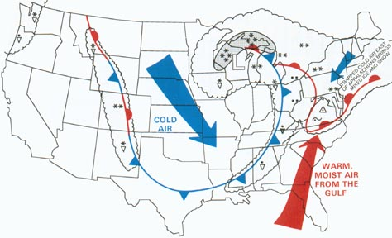
Injuries due to ice and snow
  70% from vehicle accidents
  25% occur in people caught out in a storm
  State of Kansas 2014 Kansas Traffic Accident Facts involving snow and ice.
    5, 760 accidents
    15 fatalities
    936 injuries
    4,809 Property Damage Only
Notes:
There are some sobering statistics that highlight the risks associated with winter weather conditions.
The majority of winter injuries, 70%, result from vehicle accidents. This underscores the need for extreme caution while driving in snow and ice conditions. Always adjust your speed to match the road conditions, and remember that four-wheel drive doesn’t help you stop any faster on ice.
A significant 25% of injuries occur to people caught outside in a storm, reminding us of the importance of staying informed about weather forecasts and advisories. It's always better to postpone trips when a storm is predicted.
Let's take a moment to reflect on the data from the State of Kansas in 2014.
There were 5,760 traffic accidents attributed to snow and ice conditions, leading to 15 fatalities and 936 injuries.
In addition to the human toll, there were 4,809 incidents of property damage.
These numbers aren't just statistics; they represent real people and families affected by winter weather. They highlight why we are here today – to learn how to minimize these risks and protect our community during the winter season.

Slide 5
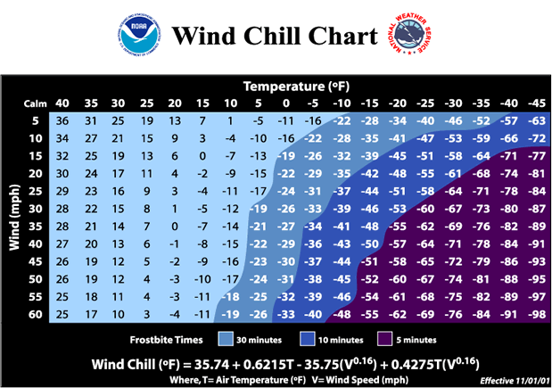
Injuries related to cold
50% of injuries happen to people over 60 years old.
More than 75% happen to males.
20% occur in the home.
Notes:
We can shed some light on the demographic most affected by cold-related injuries. It's noteworthy that half of these injuries occur in individuals over 60 years old. This age group may be more susceptible due to factors such as decreased mobility, slower metabolism, and potential for chronic health conditions, which can impair the body's ability to regulate temperature.
An overwhelming majority, more than 75%, of cold-related injuries happen to males. This could be due to a range of factors, including occupational exposure and behavioral patterns.
Additionally, 20% of injuries occur at home, indicating that even our homes can be dangerous if they are not properly heated or if individuals are not dressed warmly. It is essential to check on elderly neighbors and relatives regularly during cold snaps and to be aware that everyone, especially the elderly, may not recognize the onset of cold-related stress.
Understanding these statistics guides us towards targeted interventions and awareness campaigns, especially focused on these high-risk groups, to prevent such injuries during the cold months.

Slide 6
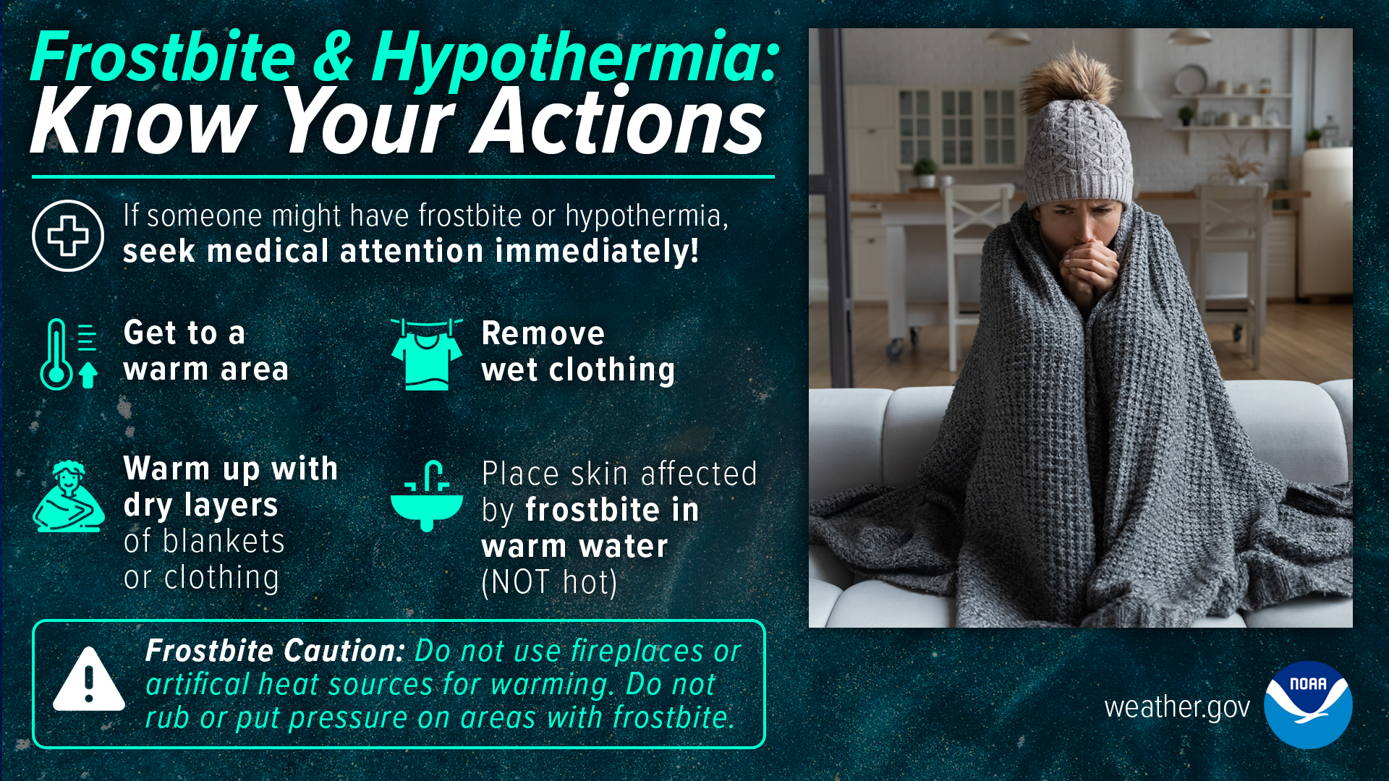
Notes:
Winter weather can pose serious health risks, especially frostbite and hypothermia. It's essential to recognize the signs and take immediate action if needed.
Seek Medical Attention Immediately
If you suspect someone is suffering from frostbite or hypothermia, prompt medical care is critical. Don't wait or take risks.
Get to a Warm Area
Always prioritize moving to a warmer environment. Staying in the cold will only worsen symptoms.
Remove Wet Clothing
Wet clothing accelerates heat loss. Changing into dry layers will help prevent further harm.
Warm Up with Dry Layers
Use blankets or dry clothing to gradually warm up. Make sure the layers are dry, as wet layers can make the situation worse.
Warm Affected Skin in Warm Water
If frostbite is present, gently warm the skin by placing it in warm water (never hot). Avoid using artificial heat sources like fireplaces or heating pads, as they can cause burns or worsen frostbite damage.
Important Caution
Avoid rubbing or putting pressure on frostbitten areas.
Do not use direct heat sources like a fire, stove, or heating pads for frostbite, as this could cause more damage.
Take these steps seriously. They could make a crucial difference during cold weather emergencies.

Slide 7
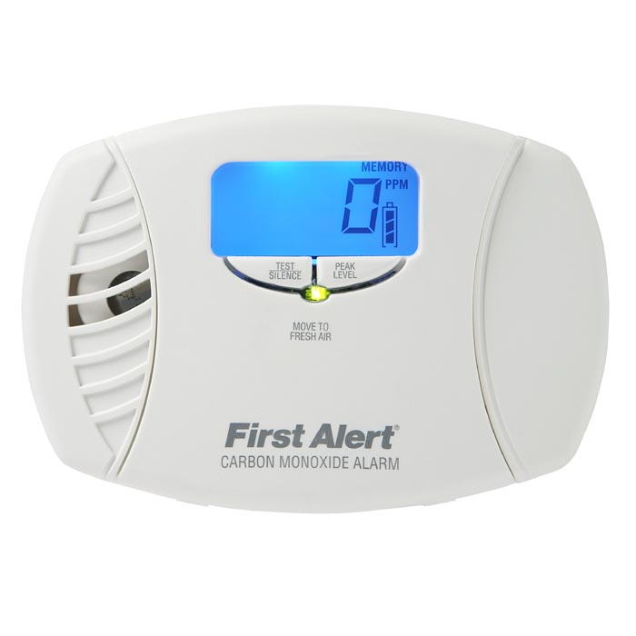
Carbon Monoxide Poisoning
During a 12 year period between 1999-2010, CDC says that a total of 5,149 deaths occurred from unintentional carbon monoxide poisoning.
Average of 430 deaths per year.
Signs:
  Dull Headache
  Weakness
  Dizziness
  Nausea or vomiting
  Shortness of breath
  Confusion
  Blurred vision
  Loss of consciousness
Notes:
We should pay attention to a silent but deadly winter hazard: carbon monoxide poisoning. Over a 12-year period, the CDC reported 5,149 deaths from unintentional carbon monoxide poisoning, averaging 430 deaths per year. These figures serve as a stark reminder of the importance of proper installation and maintenance of all heating systems, and the critical need for carbon monoxide detectors in homes.
The signs of carbon monoxide poisoning are often mistaken for common illnesses. They include a dull headache, weakness, dizziness, nausea or vomiting, shortness of breath, confusion, blurred vision, and loss of consciousness. If you or anyone else experiences these symptoms, it's imperative to get fresh air immediately and seek emergency medical care.
It’s worth noting that carbon monoxide is a colorless, odorless gas, which can accumulate indoors and is impossible to detect without a CO detector. This is why having functioning carbon monoxide detectors in your home, testing them regularly, and replacing batteries are lifesaving measures.
Additionally, never use generators, grills, or other gasoline or charcoal-burning devices inside your home or garage. Always ensure proper ventilation when using fuel-burning heaters

Slide 8
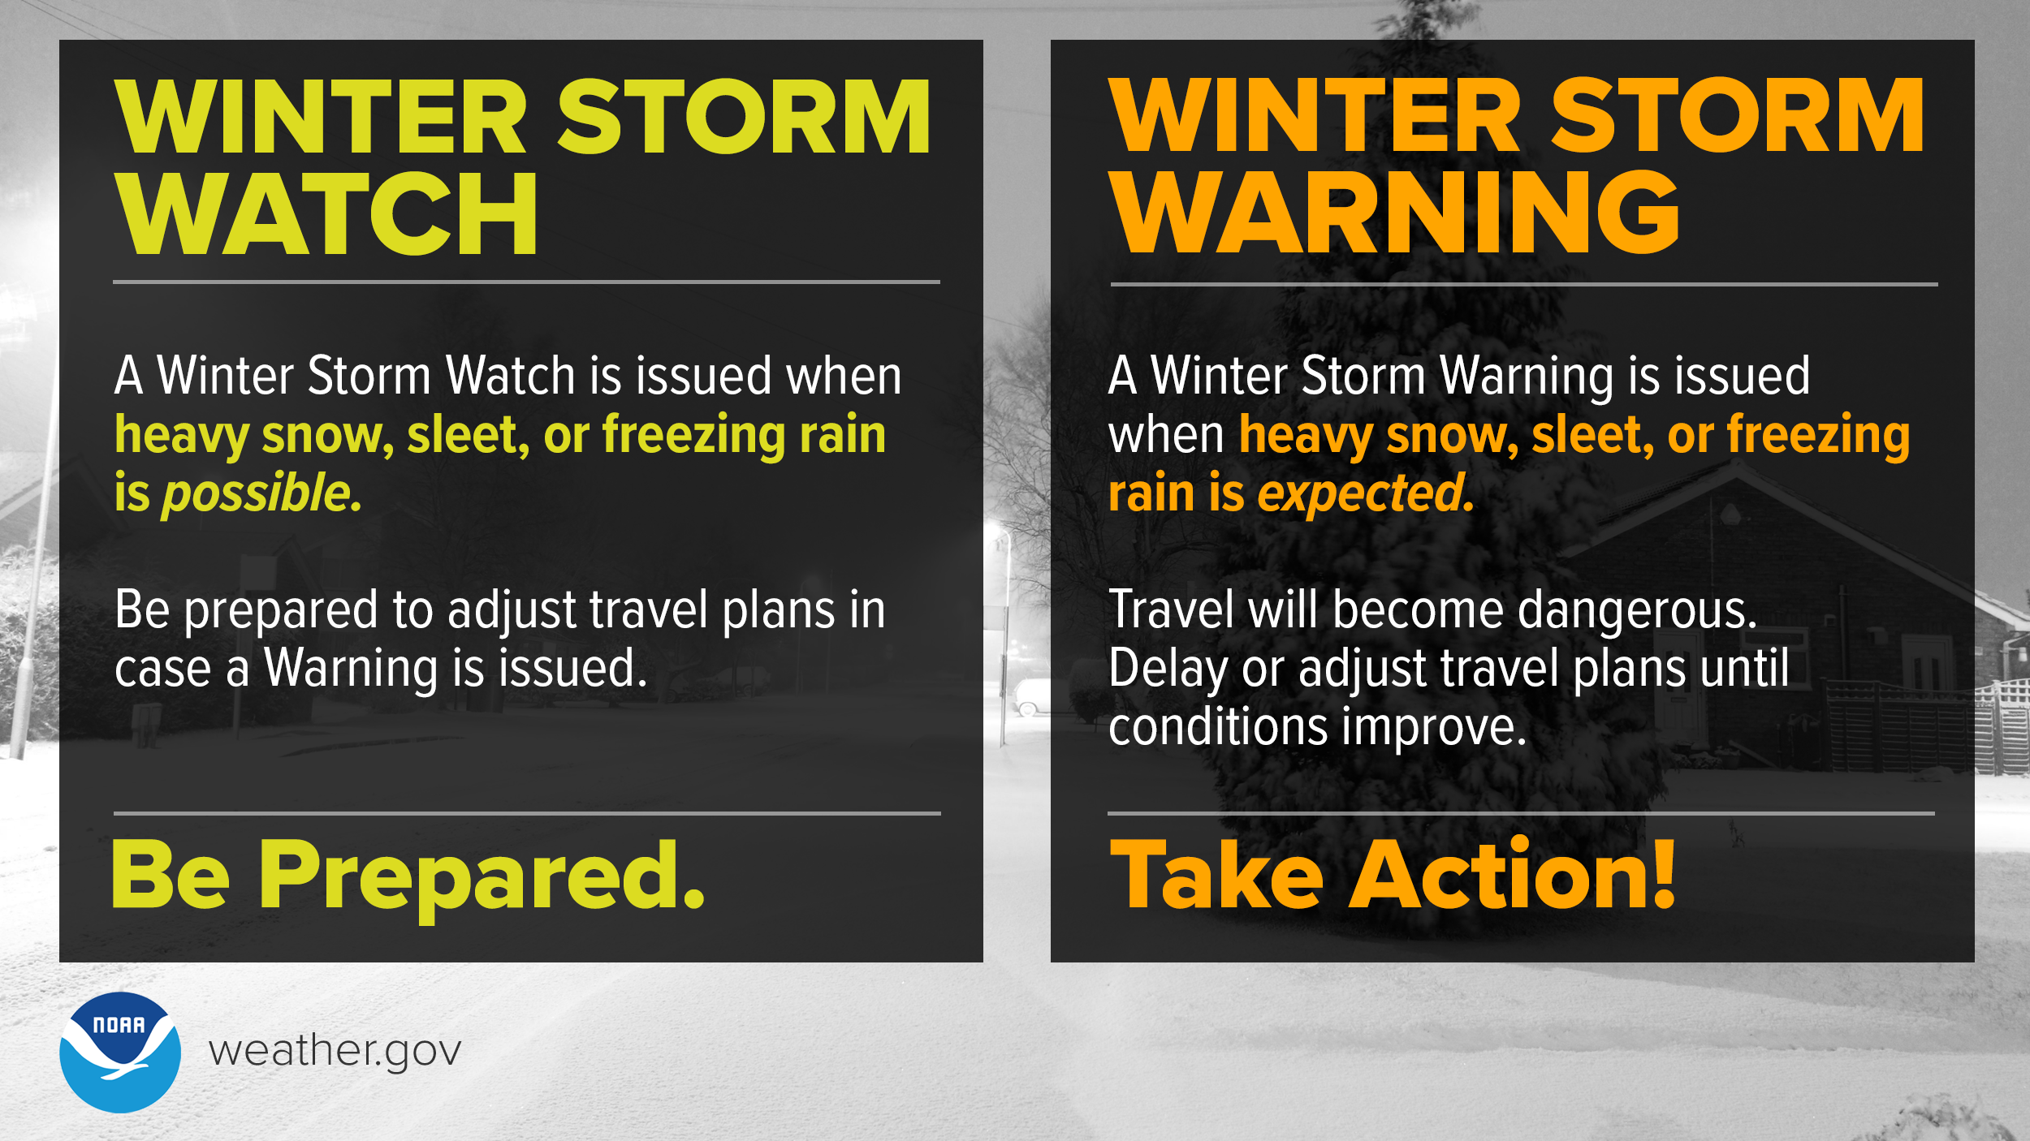
Understanding Winter Weather Alerts
WINTER STORM OUTLOOK: Winter storm conditions are possible in the next 2-5 days. Stay tuned to local media for updates.
WINTER WEATHER ADVISORY: Winter weather conditions are expected to cause significant inconveniences and may be hazardous. If you are cautious, these situations should not be life-threatening.
WINTER STORM WATCH: Winter storm conditions possible within the next 36-48 hours. PREPARE NOW!!
WINTER STORM WARNING: Life-threatening severe winter conditions have begun or will begin within 24 hours. ACT NOW!!
Notes:
Understand the various winter weather alerts you should be familiar with to effectively prepare for and respond to winter storms.
Starting with a 'Winter Storm Outlook,' this means that winter storm conditions, such as heavy snow, sleet, or ice, are possible within the next 2 to 5 days. It's your cue to stay informed by tuning into local media and updates.
A 'Winter Weather Advisory' is issued when these conditions are expected and may cause significant inconveniences. While these are generally not life-threatening, I cannot stress enough the importance of proceeding with caution if you need to travel.
Moving to a 'Winter Storm Watch,' this alert is more urgent. It means that there is a potential for severe winter weather within the next 36 to 48 hours. This is your signal to PREPARE NOW. Gather supplies, review your emergency plan, and stay updated on the latest weather forecasts.
Lastly, the most urgent, a 'Winter Storm Warning,' indicates that severe winter conditions have begun or will begin within 24 hours. These conditions are life-threatening, and immediate action is required. This is when you ACT NOW. Ensure you're in a safe location, avoid all travel, and hunker down until conditions improve.
Remember, the key to navigating these alerts is to stay informed, prepare early, and heed the advice of local authorities.

Slide 9
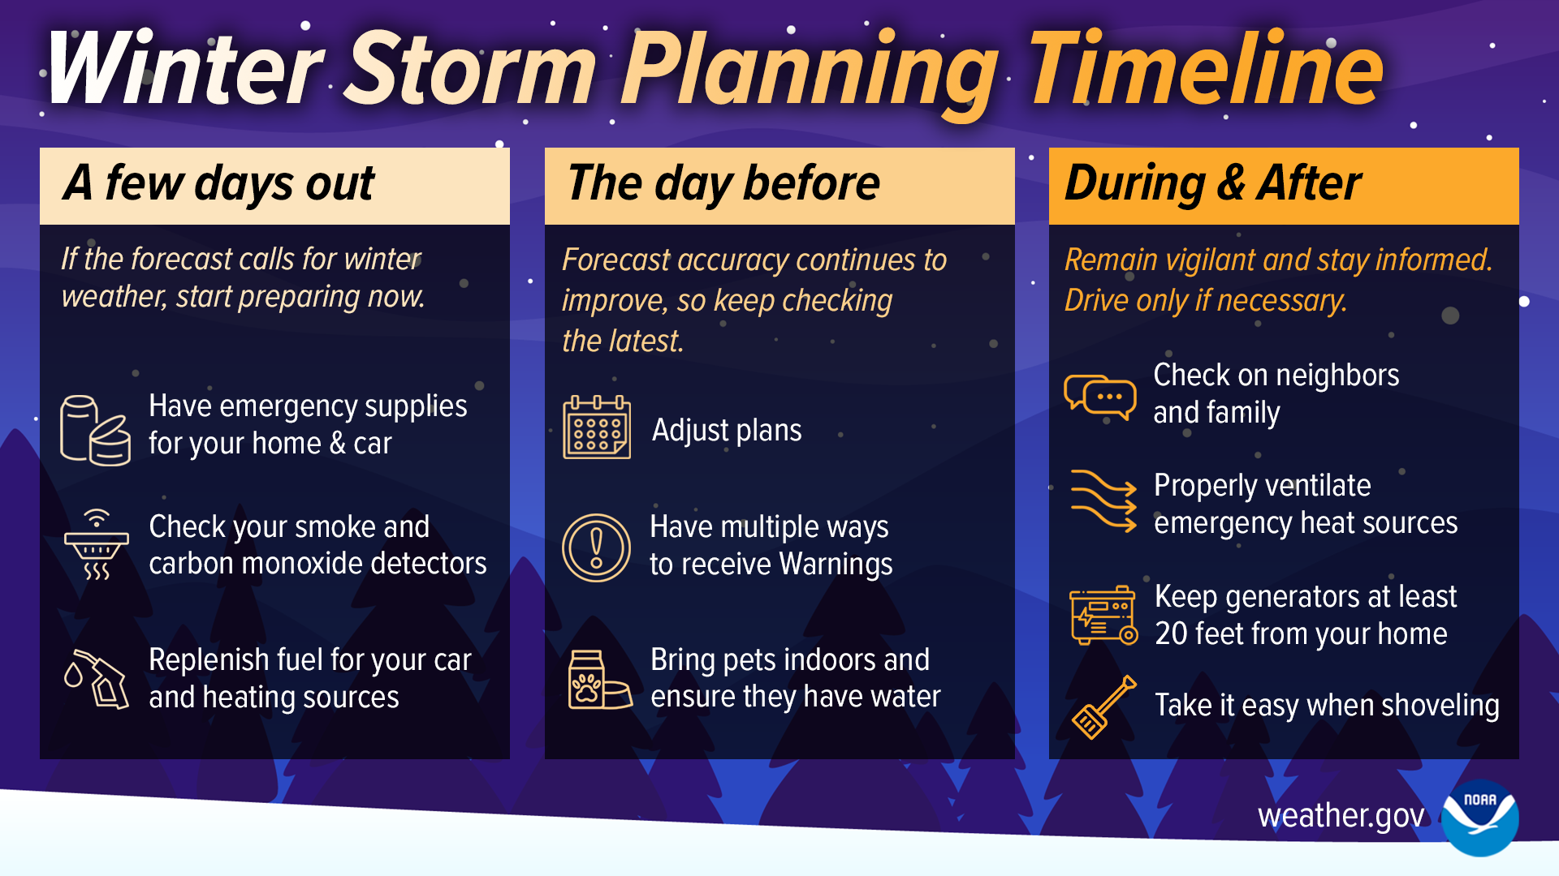
Notes:
Preparing for winter storms requires taking proactive steps well in advance. This timeline outlines what actions to take a few days before, the day before, and during a storm to stay safe and ready.
A Few Days Out: Get Ready Early
Stock up on emergency supplies for your home and car.
Check smoke and carbon monoxide detectors to ensure safety.
Refuel your car and heating sources before the storm hits.
The Day Before: Final Prep
Adjust plans and keep checking the forecast for changes.
Ensure multiple ways to get weather alerts.
Bring pets indoors to keep them warm and safe.
During & After: Stay Safe
Check on neighbors and family to ensure they're safe.
Ventilate heat sources properly to avoid carbon monoxide risks.
Place generators 20 feet from your home to prevent CO poisoning.
Take breaks when shoveling to avoid overexertion.

Slide 10

Family Communications Plan
Understand how to receive emergency alerts and warnings. Also, how to make communicate when no other forms of communications are available.
Discuss family/household plans for disasters that may affect your area and plan where to go.
Collect information.
Identify information and pick an
emergency meeting place.
Share information.
Practice your plan.
Notes:
Think about creating a robust Family Communications Plan, an essential part of your overall emergency preparedness strategy.
First, it's crucial to understand how to receive emergency alerts and warnings. Know the local channels of communication, such as emergency radio stations, community alert systems, and weather apps that can provide crucial information during a disaster.
Secondly, discuss with your family or household the types of disasters that can occur in your area and agree upon a plan of action. This includes designating a meeting place that’s familiar and easy to find.
Next, collect important personal, medical, and school information that will be needed in an emergency. Make sure every family member has a copy of this information, and consider storing it digitally in a secure and accessible cloud service.
Choose an emergency meeting place. Sometimes, not all family members will be at home when a disaster strikes. Decide on a safe, familiar place where your family can go for protection or to reunite.
Share contact information and emergency plans with each member of your household. Teach children how to respond during an emergency, and make sure they know how to contact responsible adults and emergency services.
Lastly, practice your plan regularly. Just like a fire drill, practicing ensures that everyone knows what to do and helps to keep the plan fresh in everyone's mind.
Remember, in a real emergency, your family may not be together all in one place. A good communications plan will help you find each other and stay in touch.

Slide 11
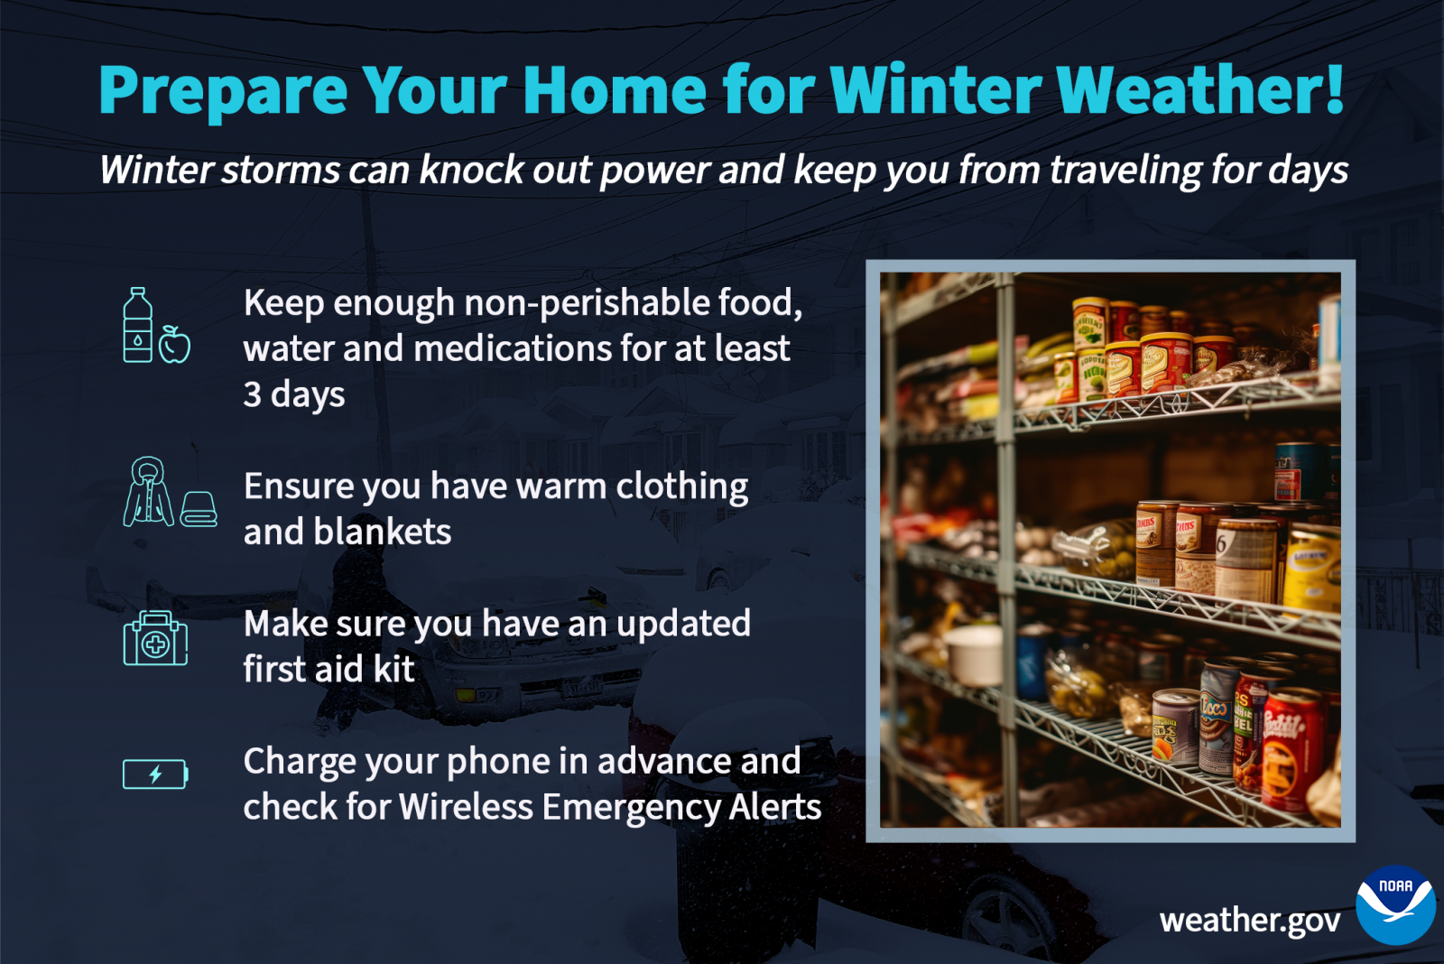
Preparations for Your Home
Flashlights & extra batteries
Weather radio & extra batteries
Extra food & water (3 day supply min-1 gal
per person per day)
Extra meds
First Aid kit
Heating fuel – heating equipment maintenance
(chimney, gas stores for generator, etc.)
Maintenance on generator-make sure it works,
is it the proper size.
Emergency heat source
Fire extinguishers
Smoke Alarm / CO2 Alarm – Carbon Monoxide Alarm
Water supply valves –at meter or in basement
Trickle water
Notes:
This is your checklist for home preparedness in the face of winter emergencies. It’s essential to ensure that your home is a safe haven during a winter storm.
Start with flashlights and extra batteries; power outages are common, and you’ll need reliable sources of light. Similarly, a weather radio with extra batteries can be a lifeline, providing you with updates when other forms of communication may fail.
Stocking extra food and water is also critical. Aim for at least a three-day supply, with a gallon of water per person per day. If you have special dietary needs or medications, ensure you have an ample extra supply.
A well-stocked first aid kit can address minor injuries and prevent infections, while maintaining your heating equipment, such as chimneys and generators, will keep you warm and prevent potential disasters.
Speaking of heat, make sure you have an emergency heat source, such as a wood stove or space heater, and understand how to use it safely.
Fire extinguishers, smoke alarms, and carbon monoxide alarms are non-negotiables; they need to be functional and accessible. Test them regularly and know how to use them.
Lastly, know where your water supply valves are to prevent pipes from freezing. Trickle a small amount of water to keep them from freezing solid.
By checking off each item on this list, you’re not just preparing your home; you’re ensuring the safety and comfort of your family during the most severe winter conditions.

Slide 12

Conserving Heat and Staying Safe Indoors
Close off extra rooms-heat conservation
Cover windows
Stuff towels and rags in cracks under doors
Wear layered clothes
Keep your pets indoors
Never heat with a stove (kitchen)
Keep dry
Generators are meant to be used (run)
outside
Avoid overexertion when shoveling snow
If using kerosene heater maintain ventilation
Eat & drink. Stay hydrated!!
Notes:
Here are some crucial tips for staying safe and warm in your home during a winter storm.
To conserve heat, close off unneeded rooms and cover windows at night with blankets or curtains. Seal the drafts under doors with towels or rags to keep the cold air out and the warm air in.
Layered clothing will keep you warmer than a single heavy garment. Remember to include a hat, as a lot of body heat is lost through the head.
Bring your pets indoors during the storm; they are also at risk from cold temperatures.
A critical safety reminder: generators should only be operated outside to prevent carbon monoxide poisoning. Similarly, never use your kitchen stove for heating—it's not only inefficient but also dangerous.
When it comes to clearing snow, take it easy. Overexertion can lead to a heart attack, one of the leading causes of death during and after a winter storm. Take breaks, push snow rather than lifting it when possible, and stay dry to prevent loss of body heat.
If you're using a kerosene heater, adequate ventilation is vital to prevent the buildup of toxic fumes.
Lastly, don’t forget to eat and drink regularly. Food provides the energy necessary to keep warm. Drink fluids to prevent dehydration, which can occur from the dry winter air and overheating of your home.

Slide 13
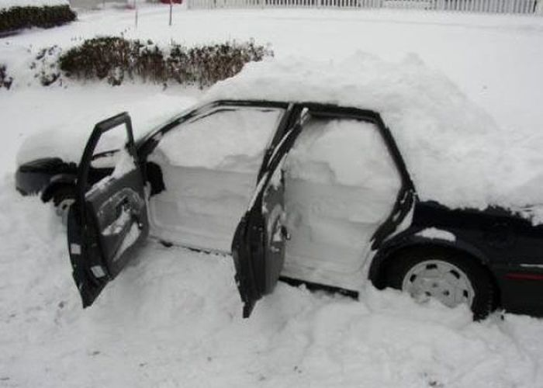
  Preparations for Your Car
Winterize your automobile
Keep a full gas tank
Check antifreeze
Battery & ignition
Brakes
Exhaust
Fuel & Air Filter
Heater & Defroster
Lights & Flashing Hazard Lights
Oil
Thermostat
Windshield wiper equipment & Rain X
Winter tires
Notes:
We should focus on preparing your vehicle for winter, which is just as crucial as preparing your home.
Start by winterizing your car. This means checking the antifreeze levels to prevent the engine from freezing and ensuring your battery and ignition system are in top working order to avoid start-up issues on cold mornings.
Keeping a full gas tank can prevent the fuel line from freezing and also ensures that you have enough fuel in case of unexpected delays or detours caused by winter weather.
Brake checks are non-negotiable in winter. Good brakes can mean the difference between a safe stop and an accident on icy roads. Also, have your exhaust system checked for carbon monoxide leaks, which can be especially dangerous if windows are closed in winter.
Don't forget about the fuel and air filters. A clean air filter improves the performance of your vehicle, and a new fuel filter ensures that your car's engine is not subjected to water or debris that may be drawn into the system during cold starts.
Your heater and defroster are vital for your comfort and for safety to maintain visibility. Check your oil and thermostat to ensure your engine runs smoothly in cold temperatures. Windshield wipers and the application of a product like Rain X can improve visibility during snowy or icy conditions.
Finally, consider winter tires. Ask yourself if winter tires are necessary for your climate and if so, make sure they are in good condition and properly inflated.
Remember, a well-maintained car is less likely to leave you stranded in cold weather. Take the time to check these items off your list to ensure your safety and the safety of others on the road.

Slide 14
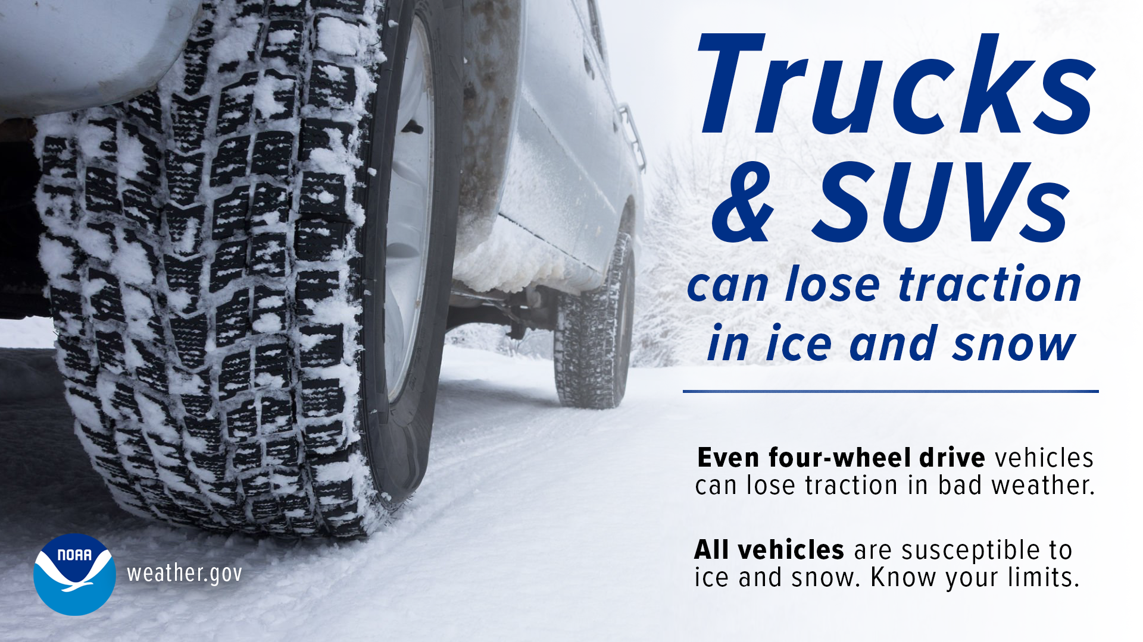
Notes:
Winter driving requires extra caution, especially when it comes to your tires. Make sure your vehicle is equipped with tires that have sufficient tread depth—at least 6/32” for snowy conditions. Consider winter tires for the best traction on icy and snow-covered roads.
Regularly check your tire pressure as cold temperatures can cause it to drop, affecting your vehicle’s performance. Keep your vehicle well-maintained with a charged battery, functioning wipers, and full windshield washer fluid to ensure you're ready for winter weather. Safe tires and proper maintenance can make all the difference when driving in snow and ice.

Slide 15
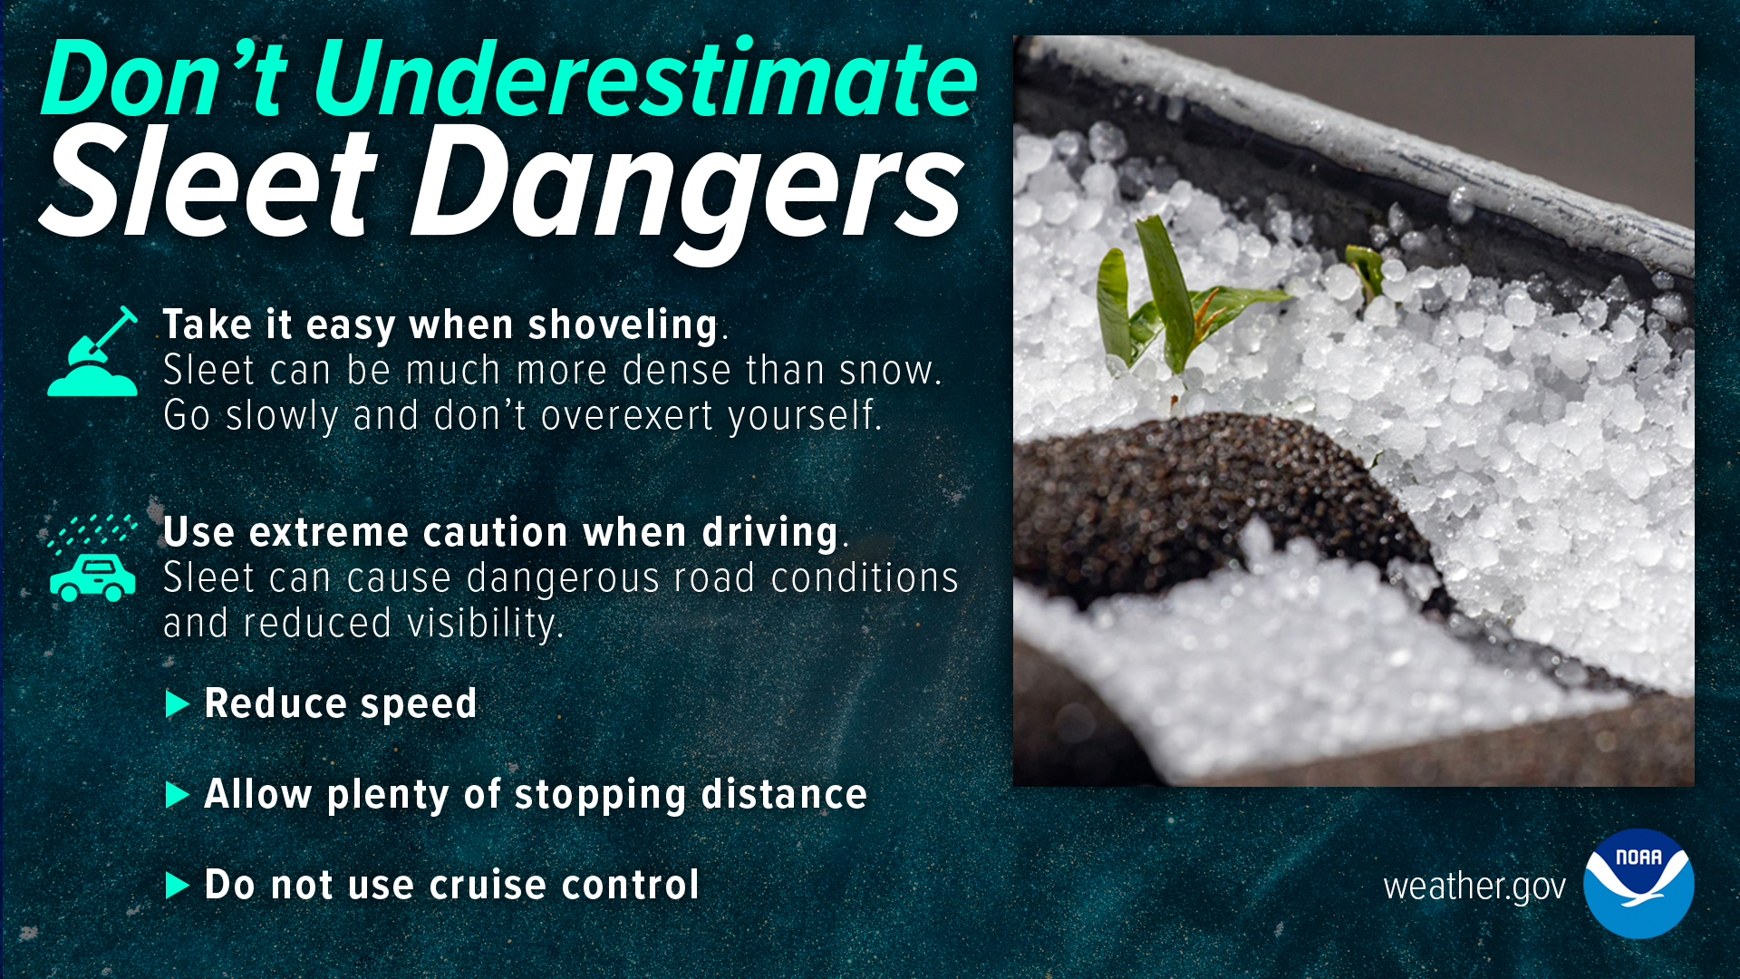
Notes:
Sleet can create dangerous driving and walking conditions, turning roads and sidewalks into slippery hazards. Even a thin layer of sleet can make surfaces difficult to navigate. Reduce your driving speed, allow extra following distance, and avoid sudden stops or turns to prevent accidents. Be cautious when walking, as sleet-covered surfaces can cause slips and falls. Taking precautions and being aware of these conditions can help you stay safe during sleet events.

Slide 16
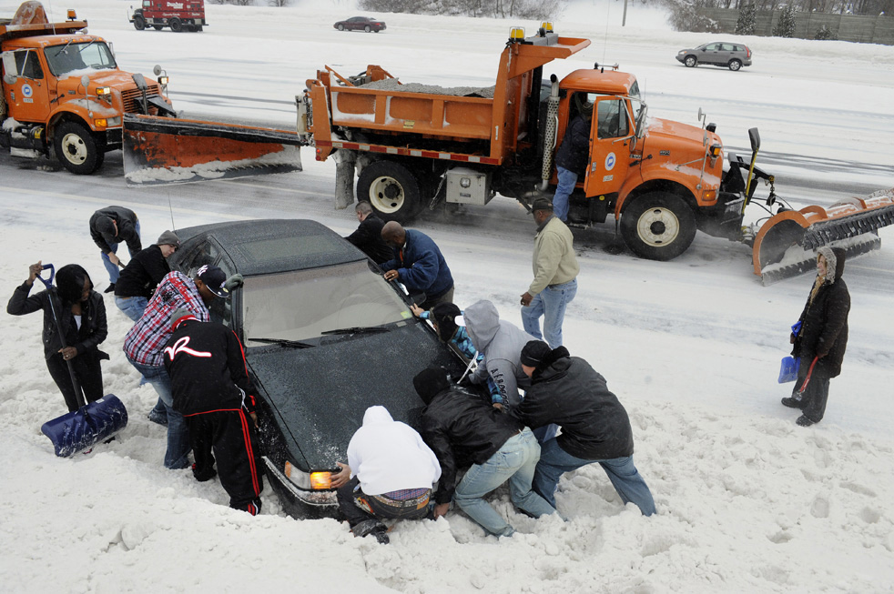
Winter Car Emergency Kit Essentials
Blankets
Flashlight & extra batteries
First Aid Kit
Knife
High Calorie Food
Extra Clothes
Matches (Waterproof)
Sand or cat litter
Shovel
Windshield Scraper
Tow Rope
Jumper Cables
Water
Sanitizer
TP
Towels
Notes:
Preparing a comprehensive emergency kit for your car is a critical step in winter readiness. Here are some of the essentials you should include.
Start with blankets; they are a must-have to keep warm if you're stranded. A flashlight with extra batteries will be invaluable during nighttime emergencies or power outages. Including a first aid kit is crucial for addressing any injuries until help arrives.
A knife can be a versatile tool for various situations, from cutting cords to preparing food. Speaking of food, include high-calorie, non-perishable items to sustain you if you're stuck for a prolonged period.
Extra clothing is vital for layering up to stay warm and dry.
Matches that are waterproof can help you start a fire for warmth in a safe location. Sand or cat litter can provide traction if your vehicle gets stuck in snow. Don't forget a shovel to dig out snow around your tires and a windshield scraper to maintain visibility.
A tow rope and jumper cables are practical items for vehicle-related emergencies, and water is essential for hydration. Sanitizer, toilet paper, and towels cover basic sanitation needs.
Each item in this kit could make a significant difference in your safety and comfort during winter emergencies. Ensure these items are well-organized in your car, and check them regularly to ensure they are in good condition and ready for use.

Slide 17
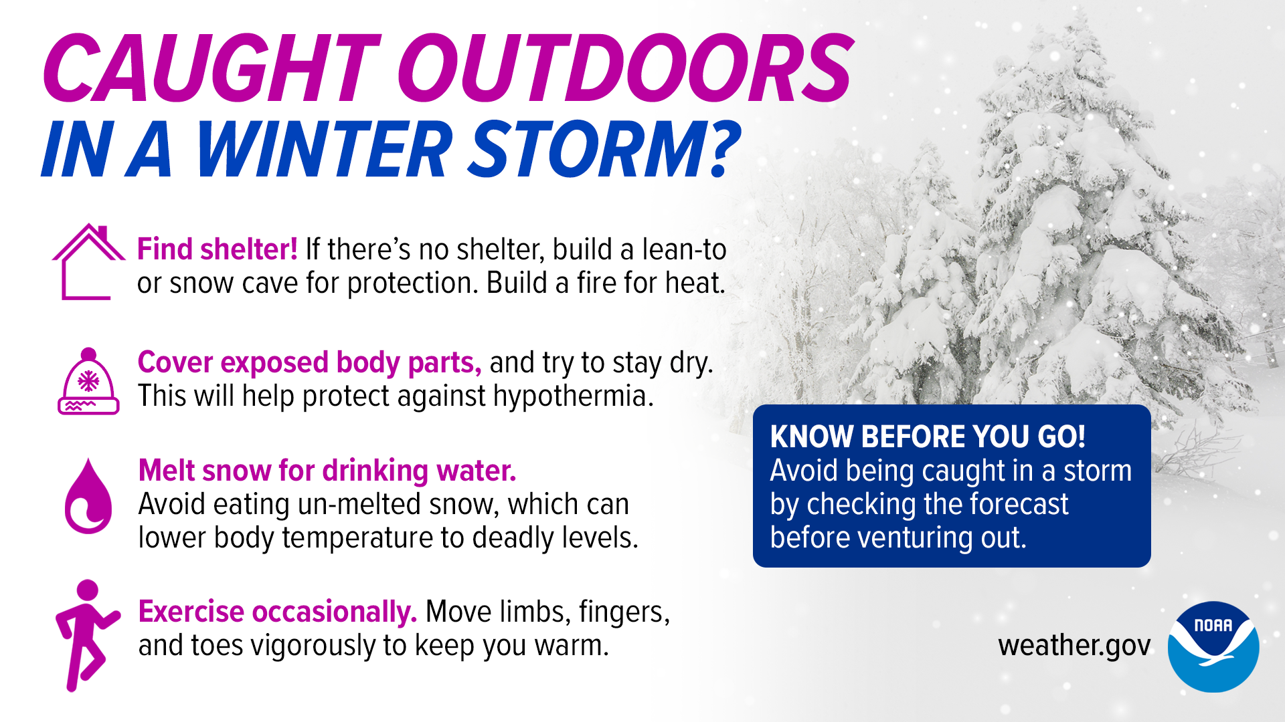
Survival Steps If Stranded in Your Vehicle.
Run the motor about 10 minutes for each hour of heat.
Open the window a little bit for fresh air-avoid CO poisoning.
Make sure exhaust pipe is not blocked.
Tie a colored cloth to the highest point on
your vehicle so others can see/find you.
Turn on inside light when running vehicle
so that rescuers can find you at night.
Notes:
This is a critical scenario: what to do if you're stranded in your vehicle during a winter storm.
If you find yourself stuck, run your car's engine for about ten minutes each hour to keep warm. But remember to crack open a window slightly while the engine is running to bring in fresh air and prevent carbon monoxide buildup inside the car.
Check that the exhaust pipe isn't blocked by snow, as this can cause deadly carbon monoxide gas to leak into the vehicle's interior when the engine is running.
To signal distress, tie a colored cloth to the highest point on your vehicle. Ideally, use a bright color like red or orange, which can be seen from a distance and in snow.
Use your car's interior lights to your advantage. Turning them on when running the vehicle at night makes it easier for rescuers to find you.
These steps can help increase your chances of being found and staying safe until help arrives. Remember to stay with your vehicle unless you know exactly where you are, how far it is to possible help, and are certain you will improve your situation.

Slide 18
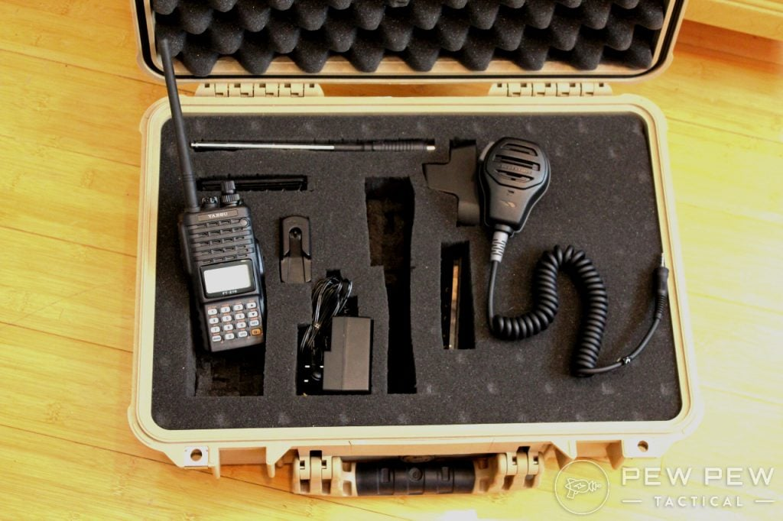
Mobile Amateur Radio Equipment Check
Check all of the connections for tightness
Check gaskets
Check all weather/rain seals for good condition
Look for breaks and tears in outer insulation
Notes:
When preparing for winter, it’s also important for amateur radio operators to ensure their equipment is in top condition for reliable communication.
Begin by checking all connections. They should be tight to prevent loss of signal and to avoid any power issues. This includes power cables to your radio and the connections to your antenna system.
Inspect all gaskets. These provide a weatherproof seal to protect your equipment from moisture which can be especially pervasive during the winter months.
Next, examine all weather and rain seals. They must be in good condition to prevent water ingress that can damage your radio and cause malfunctions.
Look for any breaks or tears in the outer insulation of cables. Exposed wiring can lead to shorts, especially if moisture gets in, and can also be a safety hazard.
Remember, the reliability of your amateur radio can be critical during emergencies, especially when other forms of communication are down.
Taking these preventative measures ensures that you can communicate effectively when it matters most.

Slide 19
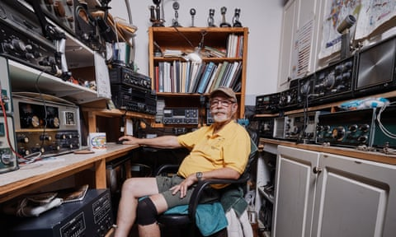
Winter Maintenance for Base Station Amateur Radio Equipment
With leaves gone, check wire antennas
Look for twists, entanglements, frayed support (guy) lines.
Check outside connections for water tightness
Replace coax now
Do repairs on Yagi’s now
Make sure all antennas will hold up to icing conditions
Notes:
As we transition into winter, it's important to conduct a thorough check of your base station's amateur radio equipment as well.
Start by inspecting wire antennas, which can be easier to see and access after the leaves have fallen. Look for any signs of twists, entanglements, or frayed support lines that could compromise their functionality.
Outside connections need to be watertight to withstand the harsh winter weather. Moisture can cause significant damage and affect the performance of your equipment, so ensure these connections are properly sealed.
Consider replacing your coaxial cable now if it shows any sign of wear and tear. It's best to handle such maintenance before the cold sets in, as the cable can become brittle and more difficult to work with in low temperatures.
Address any necessary repairs on directional antennas like Yagis. These are your workhorses for communication and should be in top condition to ensure clear, reliable signals.
Finally, ensure all antennas are prepared to withstand icing conditions. Ice can add weight and wind resistance, potentially damaging antennas and mounts.
Taking these steps now can prevent emergency repairs in the midst of winter and ensure that your amateur radio operations continue smoothly regardless of the weather.

Slide 20
Sources
CDC: Centers for Disease Control and Prevention
www.ready.gov/prepare
www.redcross.org
Winter Storms: The Deceptive Killers. A Preparedness Guide by US Dept. of Commerce, NOAA, NWS
FEMA, Dept. of Homeland Security
Kansas Dept. of Transportation Accident Statistics for 2014

